Slide 1
Modeling car sales
Presented by:
Jesse Blant

Slide 2
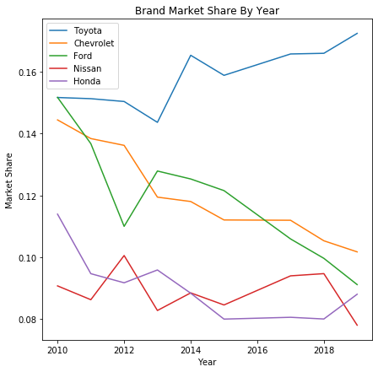
Driving market share in the competitive auto industry
Business Objective
Determine the autos consumers want that will drive sales
Modeling Objective
Build a model that can predict the sales of any auto based on its features

Slide 3
Project Introduction
Data
Data Collection
Data Processing
Modeling
13,000 Datapoints
110 models/year
10 years (2010-2019)
12 months sales/year
80 Features
Performance
Comfort
Merged Data Sources:
Consumer Reports (Scrape)
Model features
Automotive News (CSV)
Monthly sales
Clean data
Drop low sales months
Drop sparse features
Replace missing values
Regression Modeling
Baseline
Decision Tree
Random Forest
SVM

Slide 4
Data
Consumer Reports collection of 80 features across many aspects of auto models
Category | Examples
Driving | Acceleration Handling
Comfort | Space Seat comfort
Safety | Safety features Crash ratings
Category | Examples
Reliability | Reliability score
Utility | Trunk space Towing
Timing | Year Month
Automotive News monthly sales data as dependent variable

Slide 5
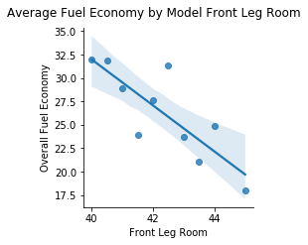
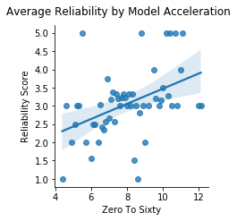
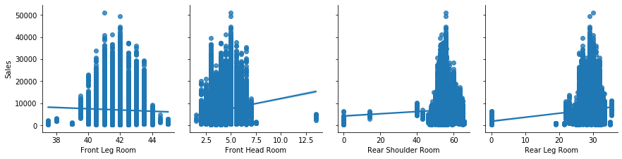
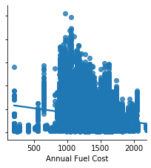
EDA: Feature complexities
Non-Linear Relationships
Interactions Among Features
Annual Fuel Cost Vs. Unit Sales By Model
Front Leg Room Vs. Unit Sales By Model

Slide 6
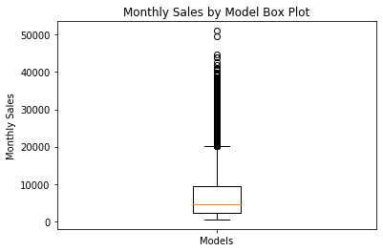
EDA: Sales OVERVIEW
Monthly sales has high Standard Deviation and many upper outliers
Monthly Sales by Model
Metric | Value
Mean | 6,990
Standard Deviation | 5,611

Slide 7
Evaluation metrics
Principle Evaluation Metric
Alternative Metrics
Validation
RMSE
MAE
R-Squared
80/20 TTS
Predictions vs. actual
Punish large misses
Predictions vs. actual
Explanatory power
Reduce overfitting

Slide 8
Modeling
Test Set Performance
Conclusions
Random Forest: Top RMSE performer
All models outperformed Baseline
All models performed similarly
Model | RMSE | MAE | R^2
Baseline | 5,095 | 3,547 | .41
Decision Tree | 2,975 | 1,688 | .80
Random Forest | 2,744 | 1,642 | .83
SVM | 2,897 | 1,534 | .81

Slide 9
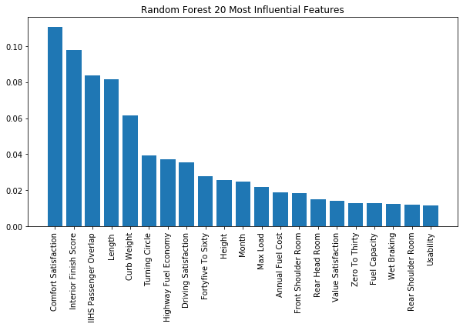
Feature Interpretation
Observations
Top 2 metrics: Comfort based
7 metrics: Space based
5 metrics: Performance based
Reliability not included

Slide 10
Next steps
Train Neural Network
Engineer more explanatory variables
Update model with 2021 models

Slide 11
Questions?
Presented By:
Jesse Blant
Contact Information:
https://www.linkedin.com/in/jesse-blant-372a523a/
https://github.com/blantj/

